Slide 1

FitGeek – Interactive fitness website
Group Members
Shreya Mahajan 20104001
Saniya Dutta 20104041
Anusha Gondhalekar 20104127
Project Guide
Prof. Sneha Dalvi

Slide 2
Contents
Introduction
Objectives
Scope
Literature Survey
Proposed System
Project Outcomes
Block Diagram
Use Case/DFD
Technology Stack
Suggestions in Review-1
Result and Discussion
Conclusion and Future Scope
References

Slide 3
1. Introduction
In today’s world fitness is the new trend which everyone is trying to catch. Yet some fitness geeks find it difficult to train their body in the right way
Problem Identified :
People rely on irrelevant knowledge and incorrect workout plans available on the internet which can cause some serious injuries or which isn’t suitable for their body type.
The right guidance available is not feasible for everyone economically.
Solution Proposed :
To overcome this issue FitGeek is here. Fitness geeks can gain knowledge to come closer to their fitness goal.
User can target a specific muscle for their workout and learn the exercise with the help of animations

Slide 4
2. Objectives
To obtain right guidance regarding fitness conveniently and economically.
To learn exercises with the help of right instructions and animations.
To keep a daily track of calorie intake.
To track nutritional intake and managing diets for healthy eating, weight loss, weight maintenance, weight gain, and fitness.
To create awareness about recent updates in healthcare.
To provide the user with an interactive chart displaying their health levels.
To provide the user with access to the exercises even remotely.
To allow the user to book appointments easily.

Slide 5
3. Scope
For modern gyms to achieve success and optimise their business potential.
To utilize resources in an efficient manner by increasing their productivity through automation.
For economical class to provide them quality fitness assistance with good deal membership.

Slide 6
4. Feature /Functionality
User can avail different exercises available on the website with the guidance of online coaches available for them at user’s convenience.
Users can track calories burnt in a day to judge their health and performance.
User can calculate their BMI for selecting a suitable workout plan in their fitness journey.
In case of emergencies, appointments with doctors can be booked via the website.
Well-designed graph depicting the calorie intake.
Users can avail different diet plans based on their body type.
Admin Account to control the access and maintain security.

Slide 7
5. Outcome of Project
Suitable and appropriate workout plans will help the users to achieve their fitness goals easily.
It has a good user interface.
To signup with the appropriate validations.
To view dashboard with calorie intake day-wise.
To view the daily news about healthcare.
To book appointments.
To track calories.
To calculate the Body Mass Index(BMI).
To pick exercises based on muscles.

Slide 8
6. Literature Review
Data collected by fitness trackers could play an important role in improving the health and well-being of the individuals who wear them. Many insurance companies even offer monetary rewards to participants who meet certain steps or calorie goals. However, in order for it to be useful, the collected data must be accurate and also reflect real-world performance.Our results demonstrate that the reporting of health indicators, such as calories burned and miles travelled, are heavily dependent on the device itself, as well as the manufacturer's proprietary algorithm to calculate or infer such data. As a result, it is difficult to use such measurements as an accurate predictor of health outcomes, or to develop a consistent criteria to rate the performance of such devices in head-to-head comparisons.
YEAR | AUTHOR | TITLE | OUTCOME | DRAWBACK
2019 | Jifeng Liang | `Research on Fitness App | It monitors users physical activity and analyses users health | They lack reliability and were not as detailed as they should be
2018 | Yudhy Dharmawan | Web-App to support Physical Fitness | The data received can be used as a mean of monitoring their own health in real time | -
2020 | Parinaz Bulky | A multipurpose sensor based system for weight training | Device monitors weight and user activities by using IMU using algo of LDA and SVM | Requires external hardware devices
2015 | Chelsea G. Bender | Measuring the fitness of fitness trackers | The fitness tracker devices are proving to be very essential for keeping a track of the user’s progress | But they are not handy also being very expensive
2017 | Lakhwinder Kaur | Influence of height and weight on Physical Fitness | The user’s height and weight data are essential for the measurement of their PFI score(essential to grade the fitness of an individual) | Height and weight aren’t the only factors to be considered while analysing a person’s fitness.

Slide 9
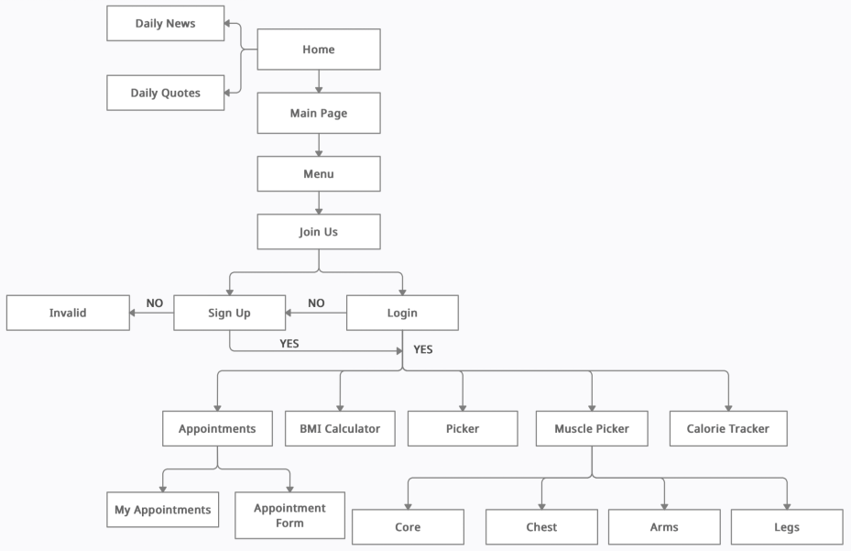
7. Block Diagram

Slide 10
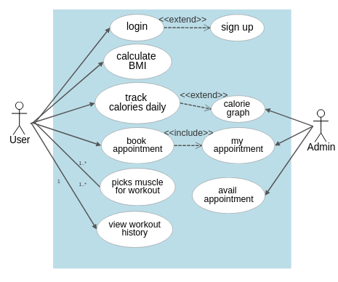
8. Use Case Diagram

Slide 11
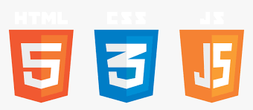

9. Technology Stack
FRONT-END: HTML, CSS, JS
BACK-END: DJANGO

Slide 12
10. Suggestions in review-1
All the premium features can be accessed only after the user logs in with his credentials.
Input validations should be applied for registration and appointment form.
There should animations for exercises rather than hyperlinks of youTube videos.
Implementation of calorie tracking on daily basis.
Adding more features and functionalities to the website.

Slide 13
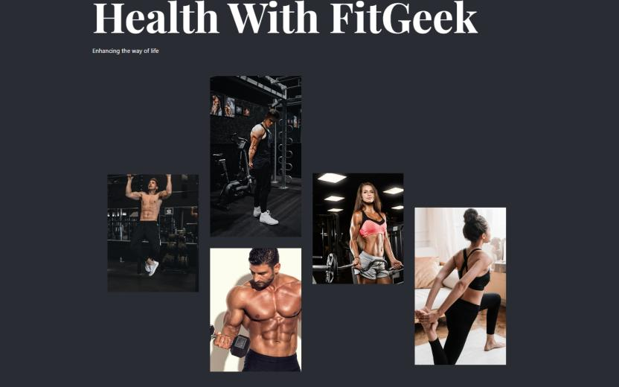
11. Results and Discussion
Home Page:

Slide 14
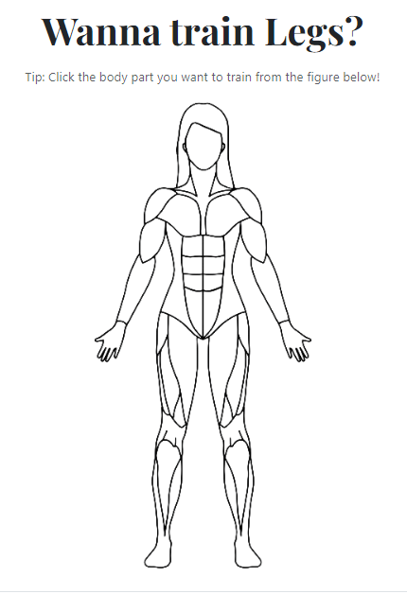
Body Picker:

Slide 15
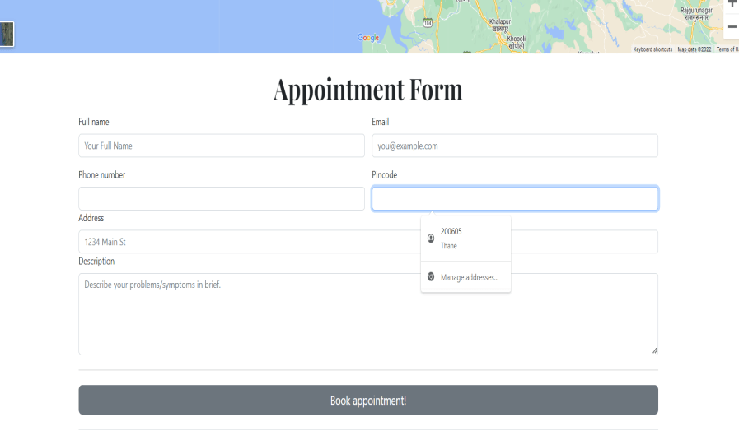
Appointment Form:

Slide 16
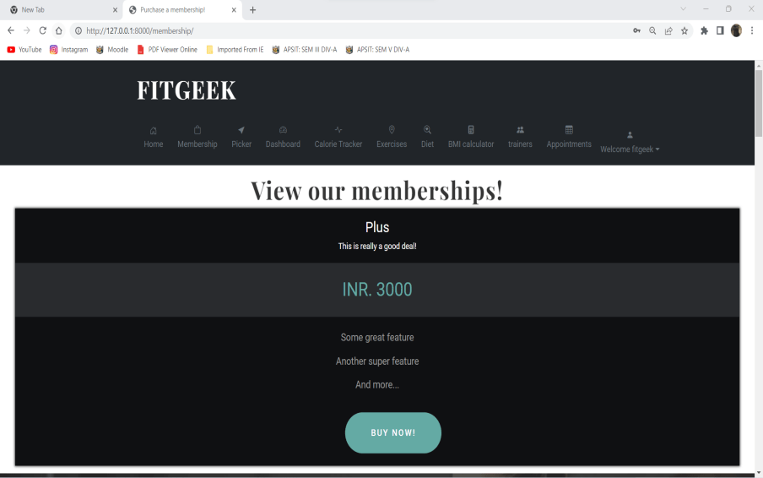
Membership Portal:

Slide 17
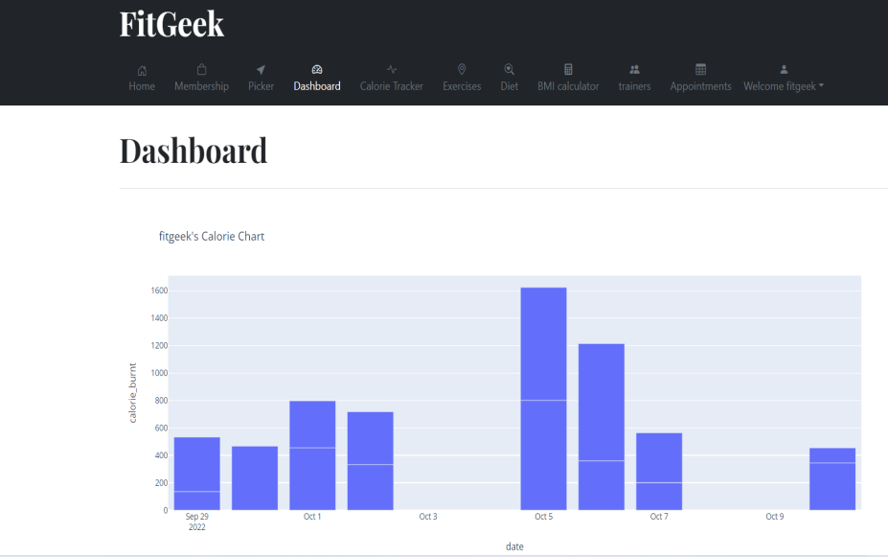
Dashboard:

Slide 18
12. Future Scope
We’ll introduce a reward based system in the future which will motivate users.
Users will earn reward based points after every successful training session which can be redeemed to purchase customized goodies available on the platform.
Chatbot for additional queries of users regarding exercises and diet plans.
Memberships designed specially for senior citizens.
Ecommerce for merchandises so customers can shop directly from the website.

Slide 19
13. Conclusion
For now, this website is static and still in development and currently provide some functions and tools and all the data in field of fitness. We are working on more knowledge and technologies and tools which are going to help in future. Its going to grow more and help many people.

Slide 20
14. References
www.researchgate.net/publication/358670122_A_Multipurpose_Wearable_Sensor-Based_System_for_Weight_Training
ieeexplore.ieee.org/document/8260796/
ieeexplore.ieee.org/abstract/document/7894077
www.irjet.net/archives/V9/i4/IRJET-V9I4323.pdf
www.irjet.net/archives/V4/i5/IRJET-V4I5128.pdf

Slide 21
Thank You...!!

